Slide 1


Internship Assignment on Git & Github.
By: Shashiknat
Notes:
Note: First “Right Click” on the Gradient background, go to “Order” option and “Send it to Back”, then insert your picture into “Image Placeholder”, “Right Click” on the picture and again go to “Order” option and “Send it to Back” to get the “Gradient” effect.

Slide 2

Tasks
www.knoldus.com
01
Create and collaborate on a new empty repository on GitHub.
01
02
Each member should make one commit each.
03
This group needs to learn and discuss on the following topic - rebase
04
You need to push the slides or the doc you create to this repository.

Slide 3
Task 1
Notes:
Note: First “Right Click” on the Gradient background, go to “Order” option and “Send it to Back”, then insert your picture into “Image Placeholder”, “Right Click” on the picture and again go to “Order” option and “Send it to Back” to get the “Gradient” effect.

Slide 4
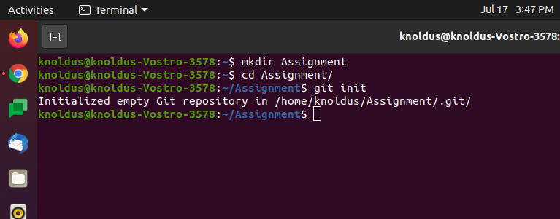
Create and collaborate on a new empty repository on GitHub.

Slide 5
Task 2
Notes:
Note: First “Right Click” on the Gradient background, go to “Order” option and “Send it to Back”, then insert your picture into “Image Placeholder”, “Right Click” on the picture and again go to “Order” option and “Send it to Back” to get the “Gradient” effect.

Slide 6
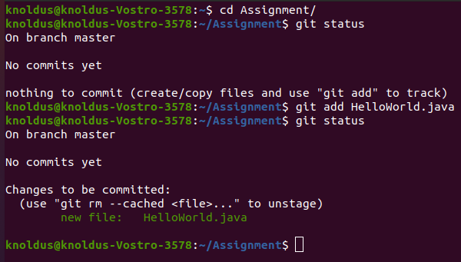
Each member should make one commit each.
Step 1 - Add a java file in Assignment repo.

Slide 7
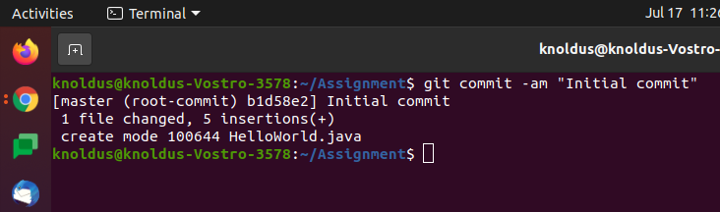
Step 2 - Use git commit for commit changes.

Slide 8
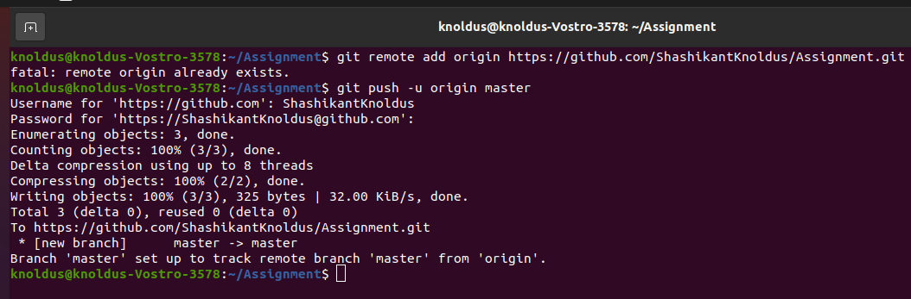
Step 2 - Push the local repo to the remote origin.

Slide 9
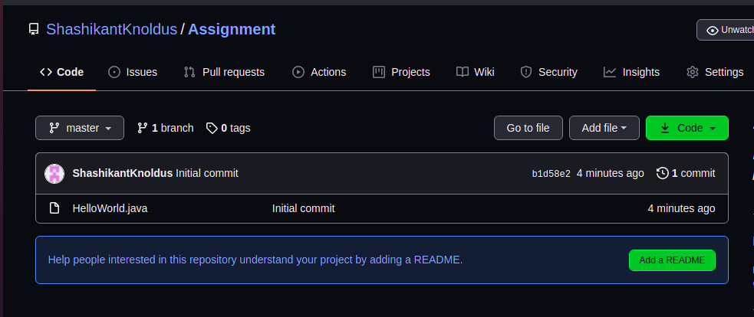
Remote repo created

Slide 10
Task 3
Notes:
Note: First “Right Click” on the Gradient background, go to “Order” option and “Send it to Back”, then insert your picture into “Image Placeholder”, “Right Click” on the picture and again go to “Order” option and “Send it to Back” to get the “Gradient” effect.

Slide 11
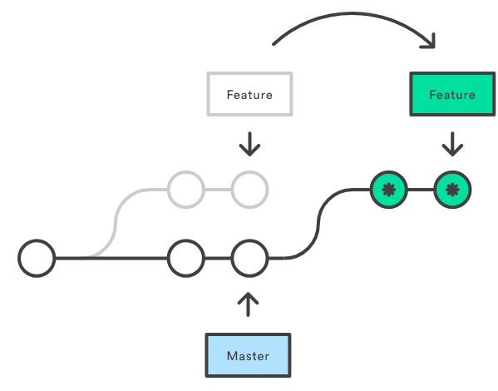
Git Rebase
A rebase is what you do when you combine a commit or series of commits to a new commit. It is similar to merging in that it moves changes from one branch to another.

Slide 12
Rebasing allows you to rewrite the history of a Git repository. When you run a rebase operation, it merges the entire history of two branches into one. This will create brand new commits for each commit in another branch inside the branch you are rebasing.
Rebasing is most commonly used to integrate changes from upstream into a local repository.

Slide 13
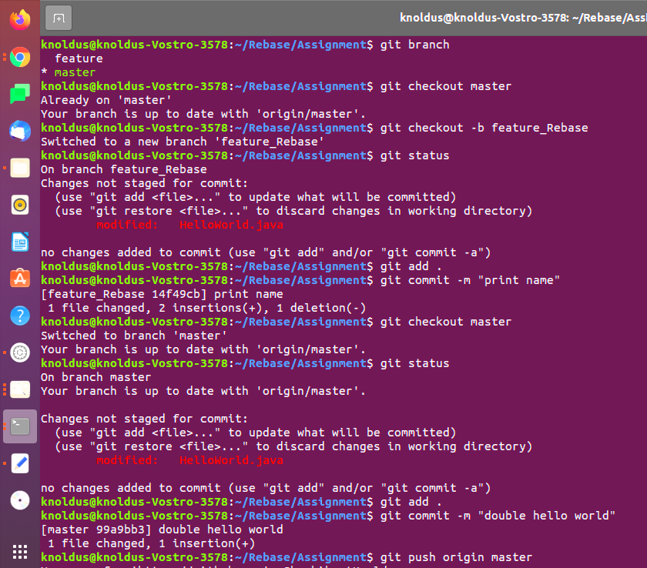
Working on feature branch and trying to merge changes on master branch

Slide 14
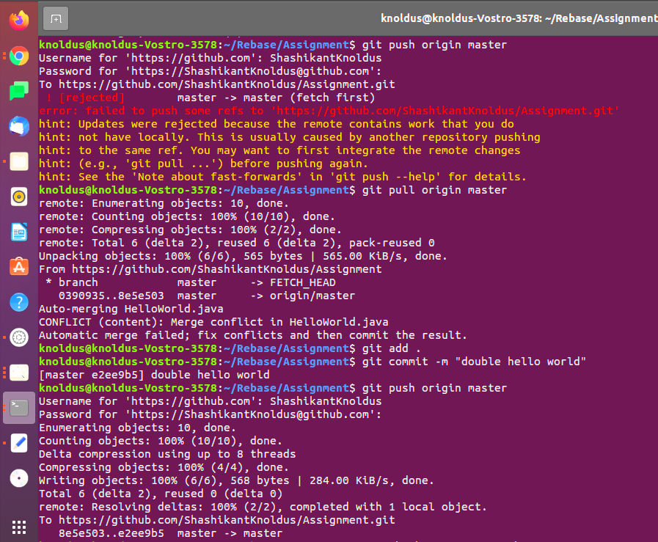
Before merging on master branch, some change are done on master branch which are not present on feature branch.

Slide 15
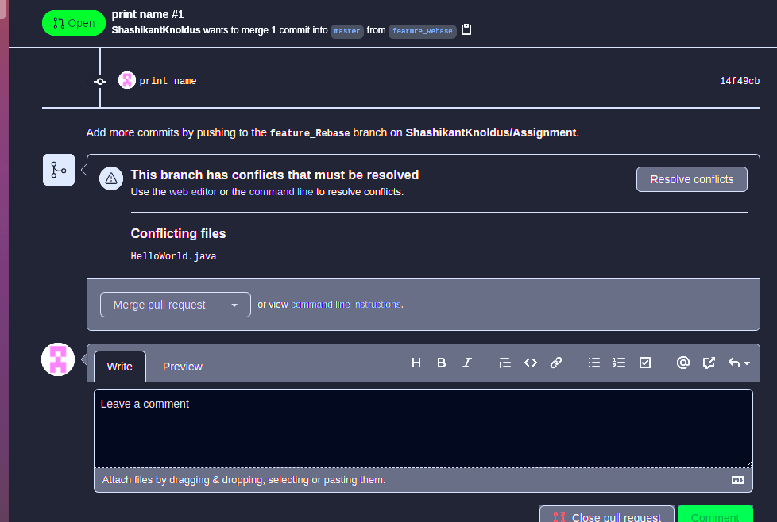
Then when we try to merge the feature branch on merge branch then conflicts are generated.

Slide 16
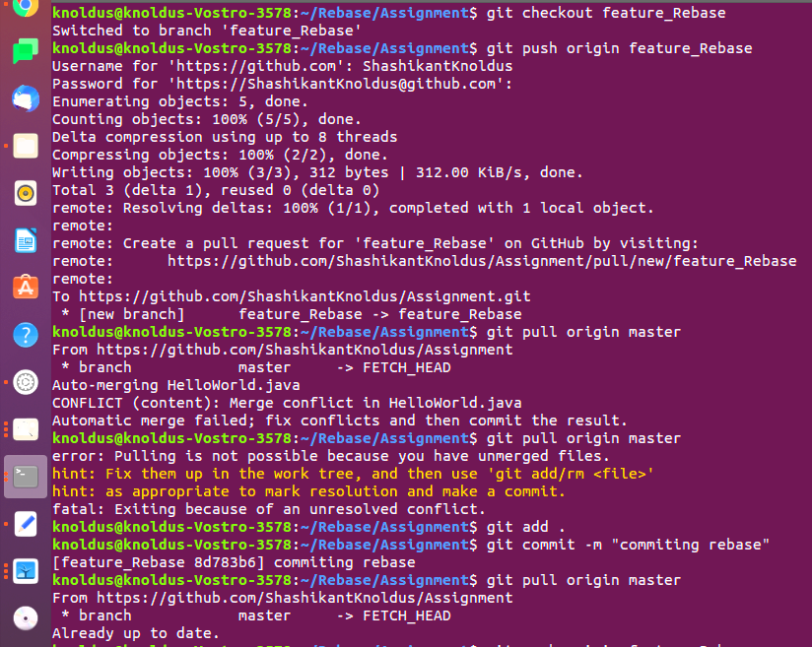
Now, performing rebasing and resolving conflicts.

Slide 17
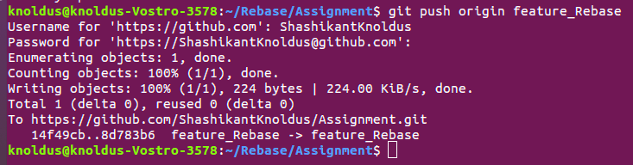

Slide 18
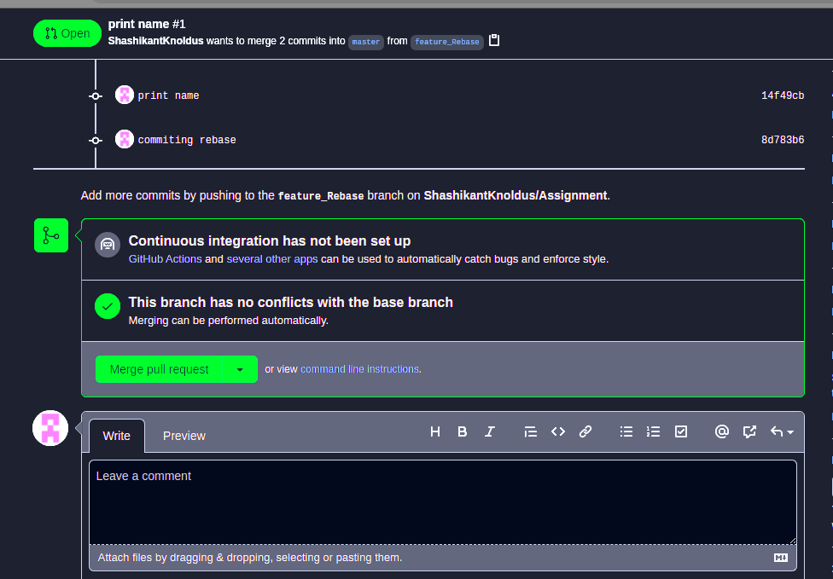
Conflicts resolve and now feature branch is merged on master branch

Slide 19
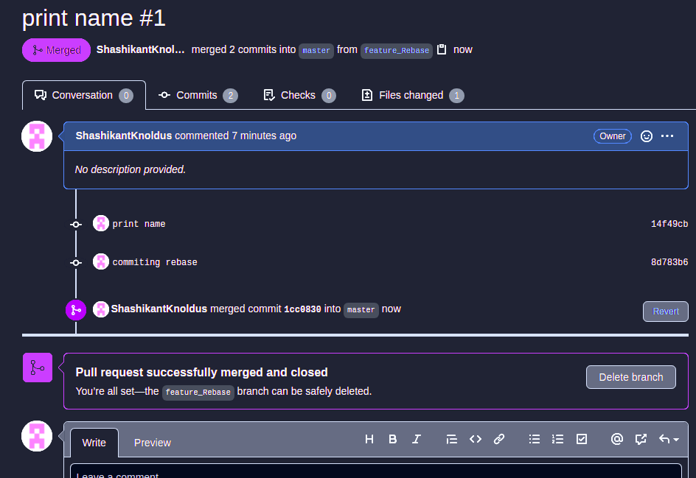

Slide 20
Thank you
Notes:
Note: First “Right Click” on the Gradient background, go to “Order” option and “Send it to Back”, then insert your picture into “Image Placeholder”, “Right Click” on the picture and again go to “Order” option and “Send it to Back” to get the “Gradient” effect.

